Slide 1

It’s time to Read!
by Matthew Holland
MGT 8823

Slide 2
Define: Business Case
As a language arts teacher teaching in Taiwan, I know from experience that reading is of utmost importance to parents. Parents here see English proficiency as a way for their children to go abroad to the USA or Europe and get an excellent education. In fact, high school graduates from Taiwan studying abroad increased by 20% from 2011-2017.
Improving the time that it takes to read a passage would show that a child is increasing his vocabulary and that he is developing skills to tackle new words, especially in early elementary school. Although not essential to reading success, improving a student’s reading speed is important.

Slide 3
Define: Problem
Goal
My students are reading aloud too slowly during class, and we are spending too much time reading our weekly stories. The median reading time is 12.62 seconds.
Problem Note: It is difficult to measure the time that my students are spending with reading aloud during class since all of the stories and the lengths of the stories are different. Therefore, I will gather data by simulating the read aloud experience. In order to control for other factors, the number of syllables and the difficulty of the text will be held constant.
Have the class reduce their reading times by 5% (on average) by the end of the calendar year 2021.

Slide 4
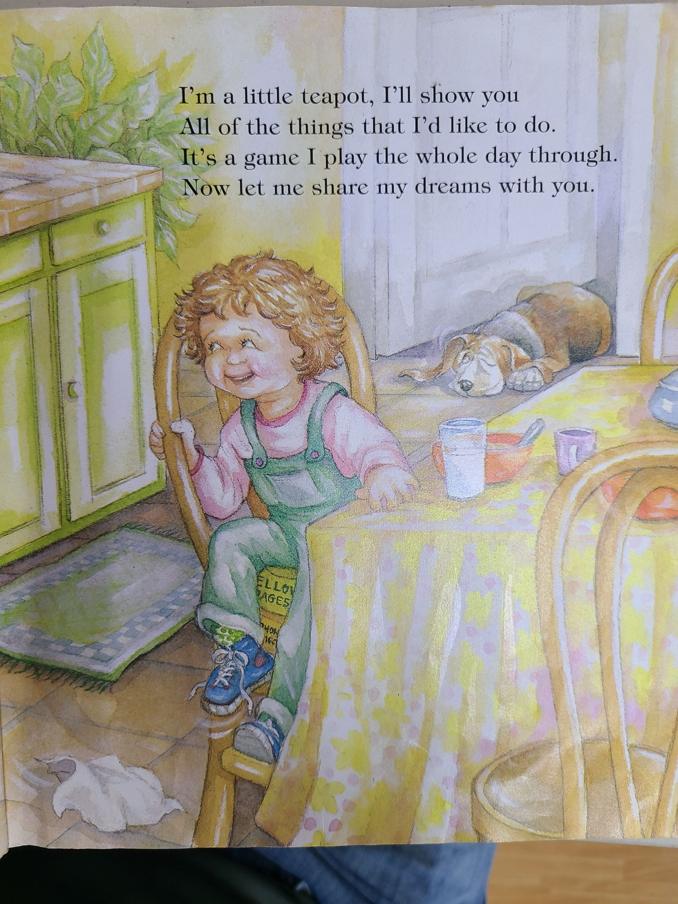
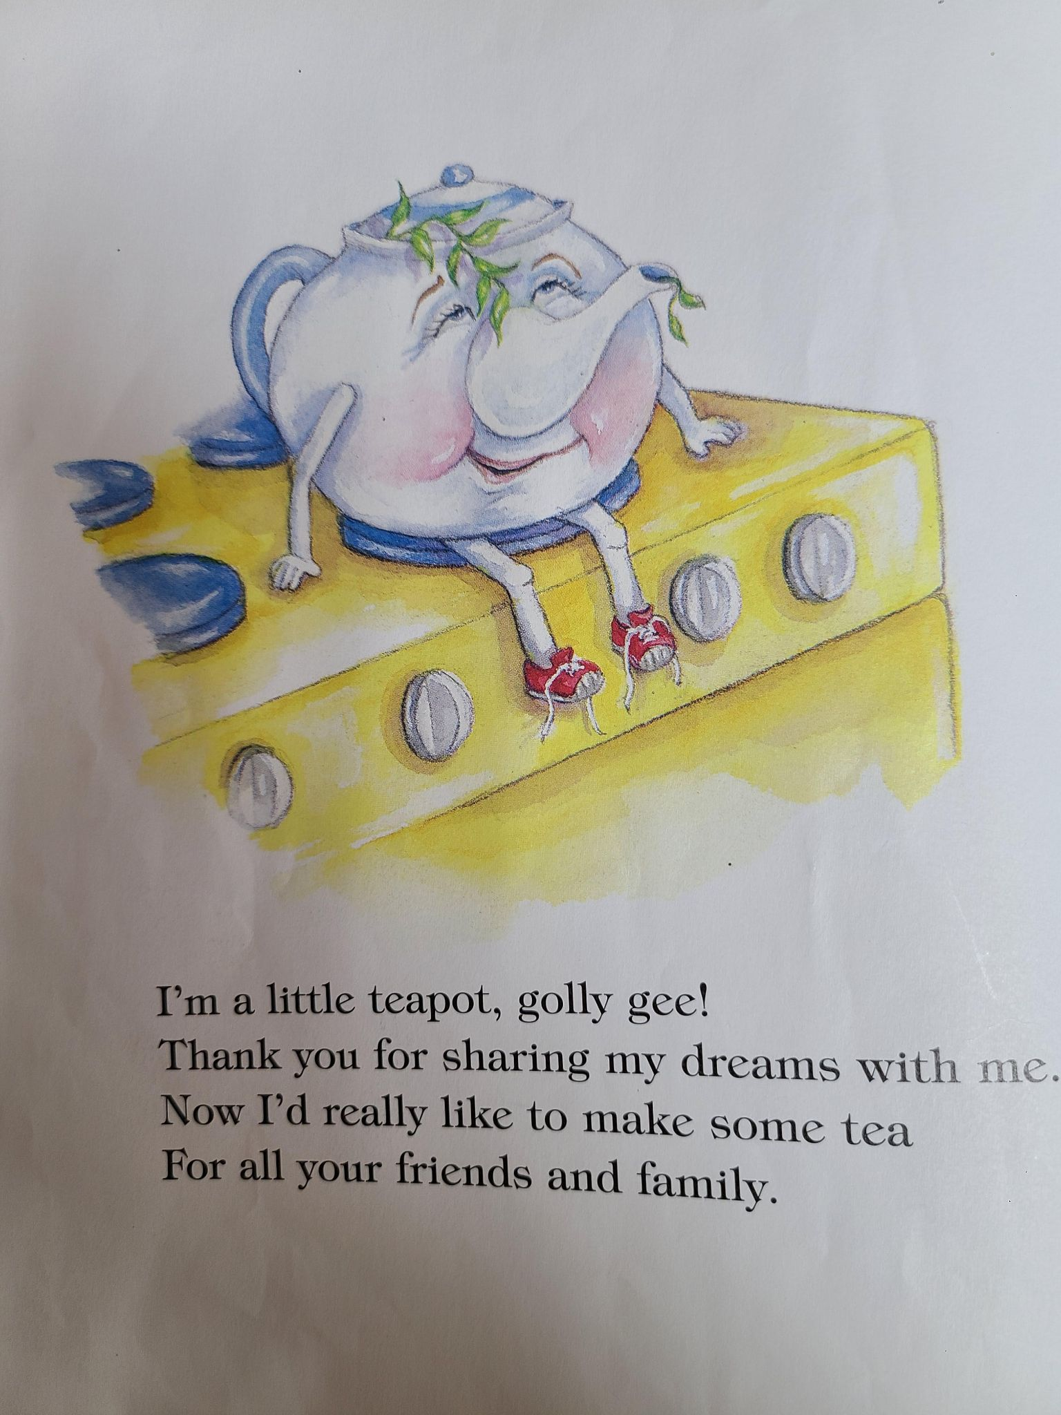
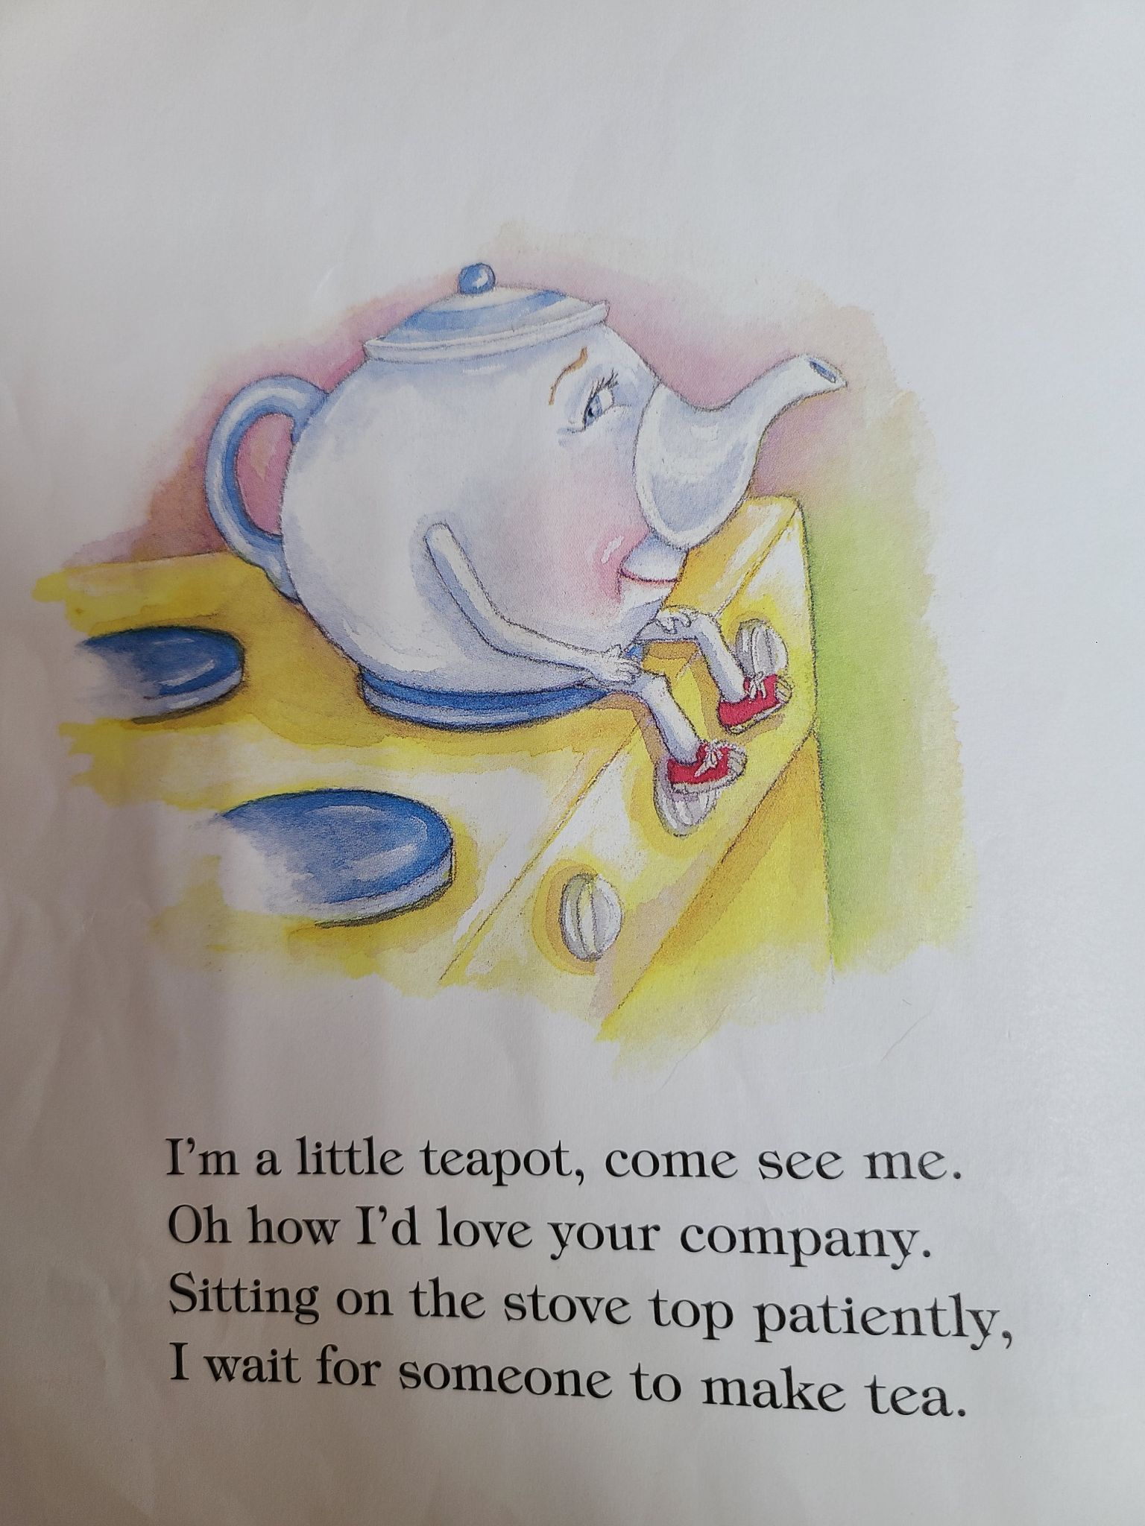
Define: Operational Definition
These pages, from the book, I’m a Little Teapot, by Iza Trapani, were read to me. These pages were chosen because they have the same number of syllables and the difficulty is similar.

Slide 5
Define: Operational Definition
Y Variable:
Reading time (Continuous): This is measured in seconds. The data was collected manually with a stopwatch app on a mobile phone.

Slide 6
Define: Operational Definition
X variables:
Student Age (Continuous): This is measured in years and expressed as a decimal.
Years attending my school (Continuous)
Number of Siblings (Discrete)
Number of times forgetting library books (Discrete)

Slide 7
Measure: Data Collection Plan
Project: Measuring Student Reading Speeds
Context: I teach second and third grade students, and I am interested in tracking their reading progress by evaluating how quickly they read. In addition, I am looking to identify struggling readers.
What questions do you want to answer? Are my students able to read with adequate fluency? Do my students have a large enough vocabulary to read a new text quickly and fluently?
How was the data recorded? The times for each page reading were recorded in Google Sheets. Subsequently, the data was transferred to the Microsoft Excel sheet provided by the instructor.
How did you ensure consistency and stability? Since I only have fourteen students, I am having them read three times in order to generate more data. This will also allow me to see if I have a student who is underperforming in regard to reading speed. Having the students read a new passage each time allows me to test the size of their vocabulary and their ability to decode new words. In order to ensure that the passages are the same length, I picked the story (song), I’m a Little Teapot, for my students to read. This ensures that the number of syllables are the same for each page. I also chose pages that did not have any overly difficult words.

Slide 8
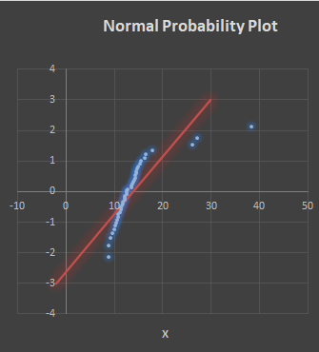
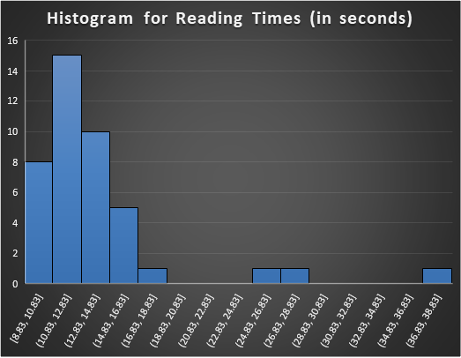
Measure: What are we working with?
Average | 13.92833
St Dev | 5.321376
n | 42
Median | 12.62
S | -1929.7
AD | 3.945
AD* | 4.021
p Value | 5.29E-10
Min | 8.83
Max | 38.27
p Value Calculations
p | 5.29E-10
From the data here, we can see that the data fails the normality test. The p-value is less than 0.05, and that means that we can reject the null hypothesis of normality. There are three points that are outliers. Therefore, we should use the median instead of the mean to center our data. The data was collected successfully. It should be noted that the outliers come from the same student. These can be seen in how heavily skewed the histogram is. Removing that one student’s scores allows us to fail to reject the hypothesis of normality. However, in education, we cannot just throw out our worst performing student in order to improve the plots that we generate. We need to work with that student to find ways to make her successful.

Slide 9
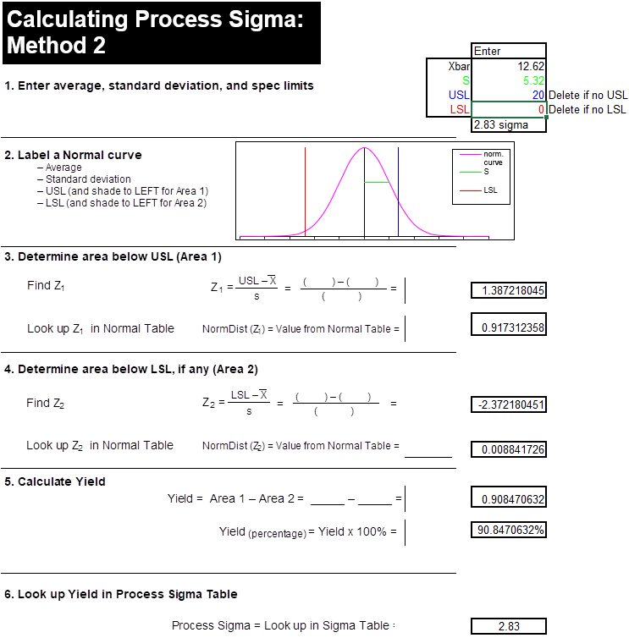
Measure: How well are we doing?
With an upper spec limit of 20 seconds, my students have a 91.7% chance of reading below that time. A score of 2.83 sigma is good, but could be improved. The problem with this data comes down to my outlier student. If his reading times can be improved, the whole class should be able to consistently meet the 20 second threshold.

Slide 10
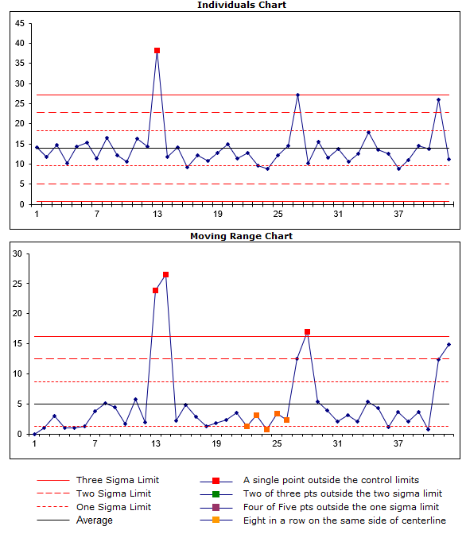
Measure: Are we consistent?
An analysis of the control chart for the individual readers shows a fairly stable process as most points fall within 3 standard deviations of the median. However, there are outlier points in both charts. These are caused by the same student. As was stated before, improving his reading times would help to stabilize the charts of the whole class. This process does not appear to have assignable-cause variation.

Slide 11
Analyze: Fishbone Diagram
The main way to improve the reading process for my class is to improve the scores of my student who is struggling with reading. In the following slide, I have devised a Fishbone diagram to hypothesize reasons why he may be struggling with reading.
Problem: My student is reading below grade level.
Notes:
© Copyright PresentationGO.com – The free PowerPoint and Google Slides template library

Slide 12
Analyze: Fishbone Diagram
Student Habits
My student reads everyday at home, but only for two minutes a day.
My student listens to books instead of reading them.
My student only reads at home once a week.
My student needs very specific books to want to read at home.
My student spends ten times
more time in front of a screen
than in front of a book.
Ability
My student has a diagnosed learning disability. (Trouble with reading accuracy, comprehension, and/or fluency)
My student’s vocabulary is well below grade level.
Problem: My student is reading below grade level.
Home Environment
My student does not have access to grade level reading materials at home.
Reading is not emphasized by the parents/grandparents at home.
Teacher
My assessments are not properly assessing my student’s reading level.
I am not effectively communicating my concerns about reading to the parents.
Notes:
© Copyright PresentationGO.com – The free PowerPoint and Google Slides template library

Slide 13
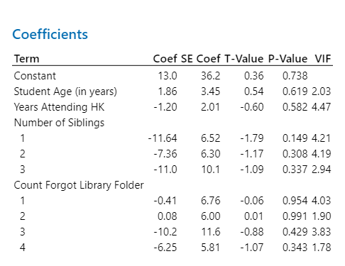
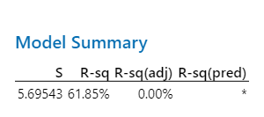
Analyze: Linear Regression
A linear regression model, calculated in Minitab, with average reading time as the y-variable and the four x-variables above contains p-values above the usual threshold of 0.05 indicating that the variables may not be statistically significant. Based on this, I cannot use the x-variables to inform my action plan. However, the model could possibly be used to predict reading times based on the fairly high R-squared value.

Slide 14
Improve: Action Plan
The x-variables that I chose do not inform a course of action to take to improve reading scores. This may be because I only have fourteen students in my sample, or it may be because of the outlier student in my class. Based on my experience as an educator in elementary education, the biggest predictor of reading success is time spent reading. So, knowing how much a student reads at home is the best predictor for reading success. However, this is difficult to track. Therefore, my plan is to practice reading verses from songs during class in October and November, and then encourage my students to read more at home. This two pronged plan will help my students to improve their reading of rhymed verses, and it will also help to build their vocabulary.

Slide 15
Improve: PICK Analysis
Possible | Implement
Kill | Challenge
Encourage students to read at home by reminding them about it.
Practice reading verse/poetry during class for five minutes every day.
Encourage parents to have their child read at home.
Hard Difficulty Easy
Provide each student with a voice recorder to assess vocabulary level.
Hire an extra teacher to spend time reading with the class each day.
Low Payoff High

Slide 16
Improve: Action Plan
Action 1: | Practice reading rhymed songs/poetry for five minutes every day from October 25-November 12. (Pick Analysis: Implement)
Action 2: | Inform parents about the importance of reading at home during parent-teacher conferences. (Fishbone Diagram: Teacher Section) (Pick Analysis: Possible)
Action 3: | Remind my students about the importance of reading at home every day from October 25-November 12. (Fishbone Diagram: Home Environment Section) (Pick Analysis: Possible)

Slide 17
Control: Improvement Stats
After communicating with students and parents about reading at home and practicing reading in verse, three different pages were chosen to read from the same book and the times were recorded. The data was collected in the same way as in the measure phase.

Slide 18
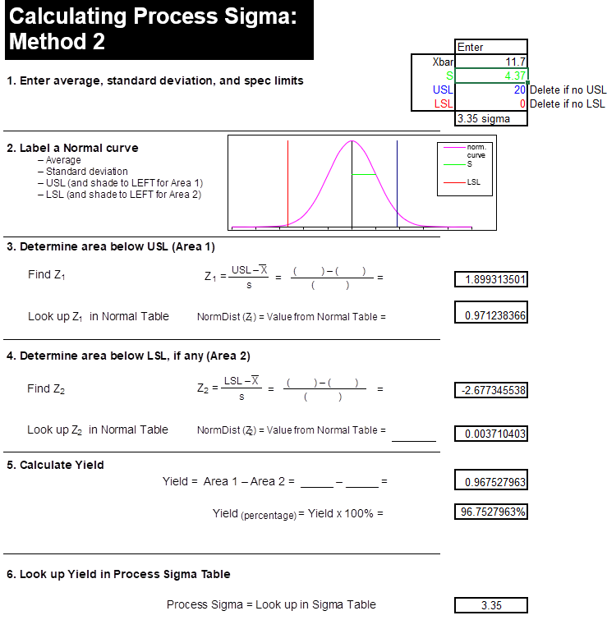
Control: Improvement Stats
I again chose to use the median for Xbar since the data for my second reading test failed the normality test. With an upper spec limit of 20 seconds, my students now have a 97.1% chance of reading below that time. A score of 3.35 sigma is up from 2.83 in the first dataset.

Slide 19
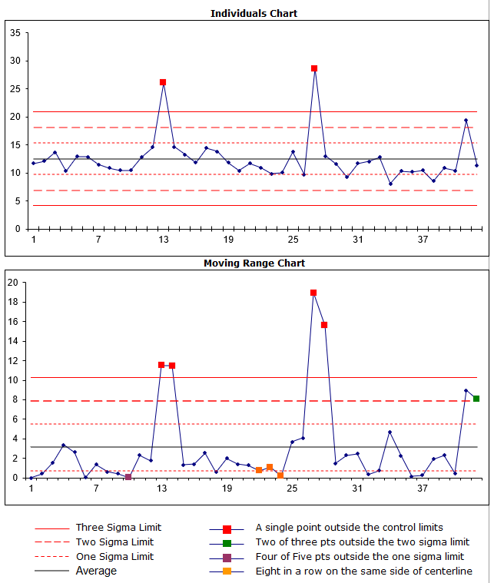
Control: Improvement Stats
Outlier points remain outside of three standard deviations of the mean, but the maximum value is lower than in the first dataset. It is still a relatively stable process outside of one student.

Slide 20
Control: Improvement Stats
 | September Average Reading Times | November Average Reading Times | Difference | Percent Difference
Class | 12.62 | 11.70 | -0.92 | -7.29%
Student 1 | 14.54 | 12.18 | -2.36 | -16.23%
Student 2 | 10.89 | 11.07 | 0.18 | 1.65%
Student 3 | 13.5 | 13.27 | -0.23 | -1.70%
Student 4 | 10.52 | 12.07 | 1.55 | 14.73%
Student 5 | 13.16 | 12.53 | -0.63 | -4.79%
Student 6 | 16.04 | 10.48 | -5.56 | -34.66%
Student 7 | 12.16 | 11.21 | -0.95 | -7.81%
Student 8 | 13.92 | 10.7 | -3.22 | -23.13%
Student 9 | 10.18 | 10.28 | 0.1 | 0.98%
Student 10 | 10.07 | 9.72 | -0.35 | -3.48%
Student 11 | 14.32 | 12.49 | -1.83 | -12.78%
Student 12 | 14.21 | 11.57 | -2.64 | -18.58%
Student 13 | 30.45 | 24.71 | -5.74 | -18.85%
Student 14 | 11.03 | 13 | 1.97 | 17.86%
The class average for reading times was down by more than 7.29%, meeting the goal for the project. 10 of the 14 students were able to improve their reading times from September to November. 7 of the 14 students were able to improve their reading average by more than five percent. Most importantly, my struggling student was able to improve his reading speed by 18.85%. While his reading speed is still above the upper spec limit, seeing improvement is a positive development.

Slide 21
Control: New Rules
After seeing the success with which reminders about reading had in my class, I will practice reading aloud with my students in some form each day, and I will also remind them (and their parents) more often about reading at home. These small steps will go a long way toward improving reading times, and ultimately, reading skills.

Slide 22

Conclusion
Reading times are important to assess as an educator because they can give you insight into your students’ vocabulary and reading fluency. Working with struggling students not only helps those individual students, but also helps to get your whole class on the same page. Finally, finding ways to improve instruction through evaluating processes and data is a great way to ensure that your students get the best education possible.

